Slide 1


How Many Wonders are there in the World ?

Slide 2
Problem Solver
Solving a problem using Technology
TECHNOLOGY
Problem
Engineer
Solution

Slide 3

“Customized 3D Printed Motorized Walking Aid for a patient with Hemiplegic gait affected by Stroke”
By
Praveen raj Masilamani
Arjun Singh Marjara
Akhil Sinai Bhangui

Slide 4
Today’s Agenda
01
Targeted Patient – Background Information
02
Methods Adaptation
03
State of Art for Suggested Device
04
Biomechanical Parameters and Feasibility

Slide 5


Slide 6
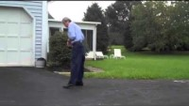
Patient with Hemiplegic Gait

Slide 7


6th
[2]

Slide 8
01
Targeted Patient – Background Information
The main motto of Motorized walking aid is to give walking assistance to patient without affecting the gait pattern.
Targeted Audience: Patient with Hemiplegic Gait who are not able to attend training/ during training.
Severity Level: Mild to Medium
Age Limit : Below 45 (For easier Adaptation) [6]

Slide 9
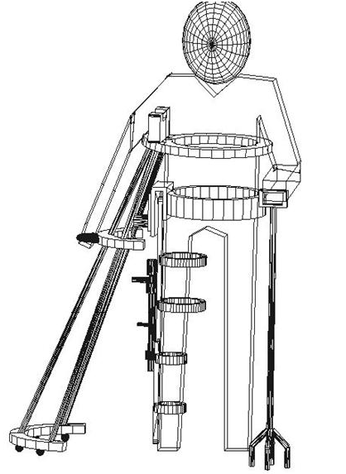
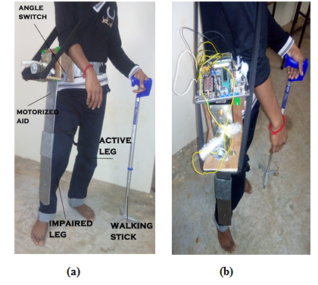
02
Method Adaptation – Overview
[1]
[1]

Slide 10
Method Adaptation – Detailed View
Iterations after each week
Fixing Motor Torque Values
Methods
Torque Calculations for Motorized Aid
Checking Muscle Activations

Slide 11
Method Adaptation – Detailed View
1
Checking Muscle Activations
2
Torque Calculations for Motorized Aid
3
Fixing Motor Torque Values
4
Iterations after each week

Slide 12

04
Biomechanical Parameters and Feasibility
1
Checking Muscle Activations
EMG Sensor
Delsys EMG Sensor

Slide 13


2
Torque Calculations for Motorized Aid
Anthropometry Chart
MRI scan data

Slide 14
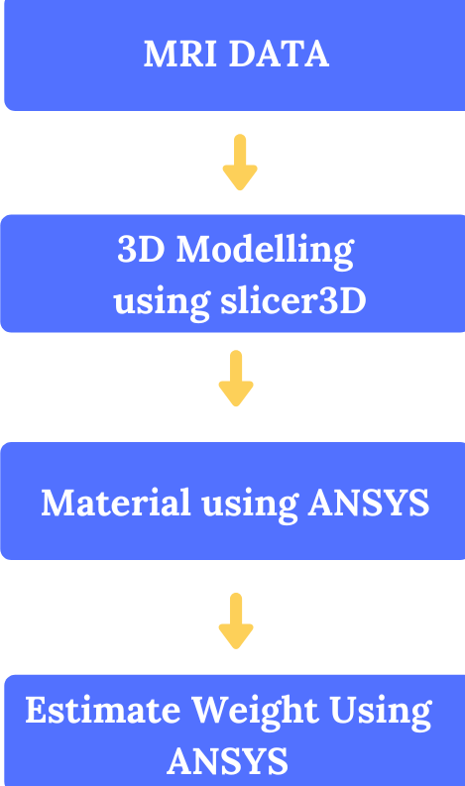

Slide 15
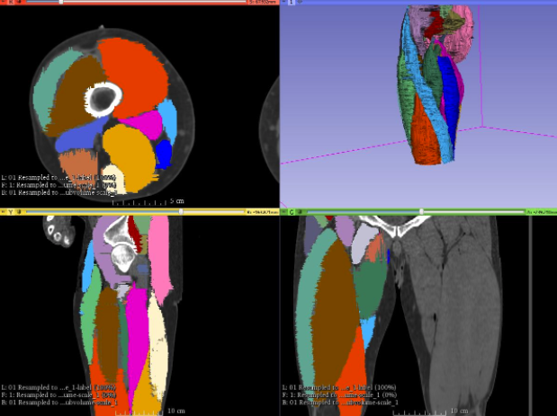
[7]

Slide 16

Fixing Motor Torque Values
3

Slide 17
4
Iterations after each week

Slide 18
03
State of Art for Suggested Device and References
[1] A complete walking-aid for paralytic patients caused by stroke – IEEE
[2] The Process of Recovery: After Hemiplegia - AHA
[3] Considerations in measuring cartilage thickness using MRI: factors influencing reproducibility and accuracy – ELSEVIER
[4] A New Method of Reconstructing the Human Laryngeal Architecture Using Micro-MRI - – ELSEVIER
[5] A Finite-Element Model for the Mechanical Analysis of Skeletal Muscles – ELSEVIER
[6] https://www.sutterhealth.org
[7] https://www.anatomus.com/blog/teaching-anatomy/building-3d-human-phase-3-muscular-system/

Slide 19

Let's make a better world using Technology!

Slide 20
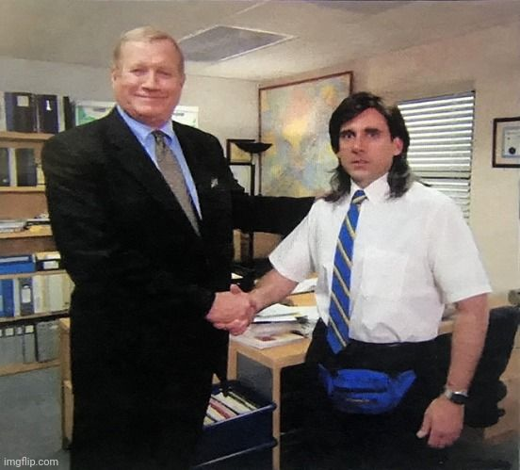

Slide 21

Notes:
You can safely remove this slide. This slide design was provided by SlideModel.com – You can download more templates, shapes and elements for PowerPoint from http://slidemodel.com

